Slide 1
Team NARAL
Anna-Sofia Lesiv, Connie Li, Ramin Ahmari
Spring 2017

Slide 2
Challenge:
Facilitate access to safe pregnancy clinics for women.

Slide 3
Tale of Two Projects
1: CPC Finder
Create Chrome extension that highlights crisis pregnancy clinics online.
CPC: a non-profit organization that counsels pregnant women not to have abortions (& uses deceptive ads).
Guide women seeking an abortion toward safe pregnancy clinics.
2: Business Shamer
Create app that informs shoppers which brands / businesses support discriminatory policies and candidates.
Promote social responsibility and accountability.

Slide 4
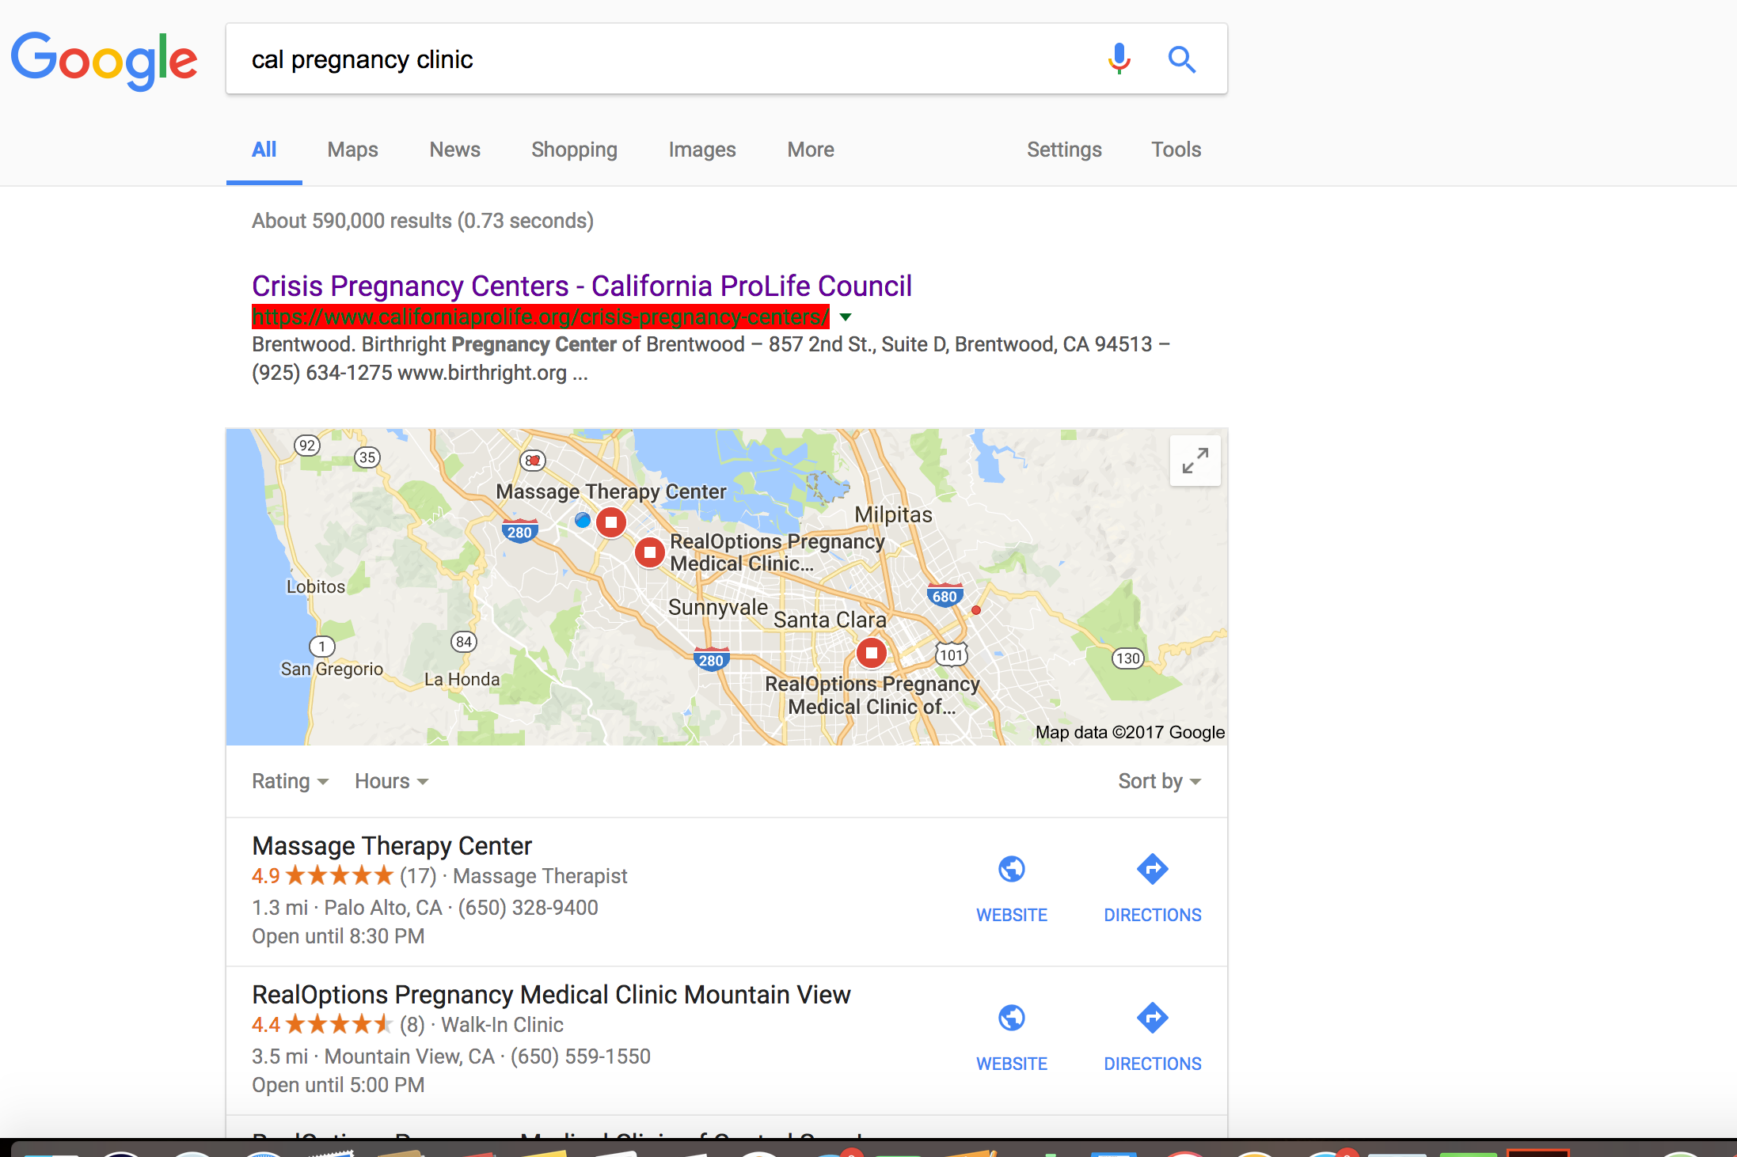
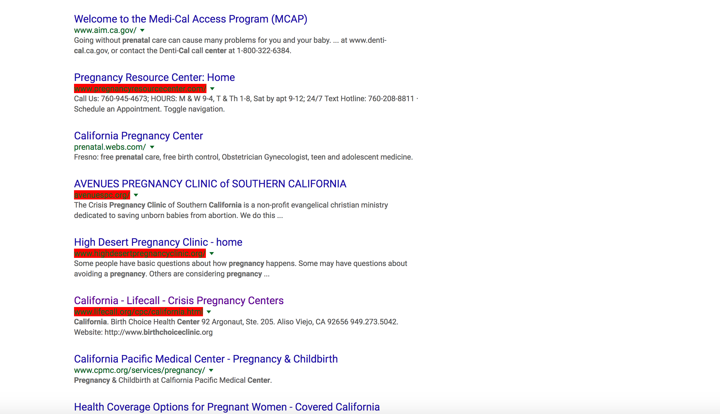
CPC Finder: Chrome Extension
Create database of crisis pregnancy clinics
Identify CPCs when they pop up on webpages

Slide 5
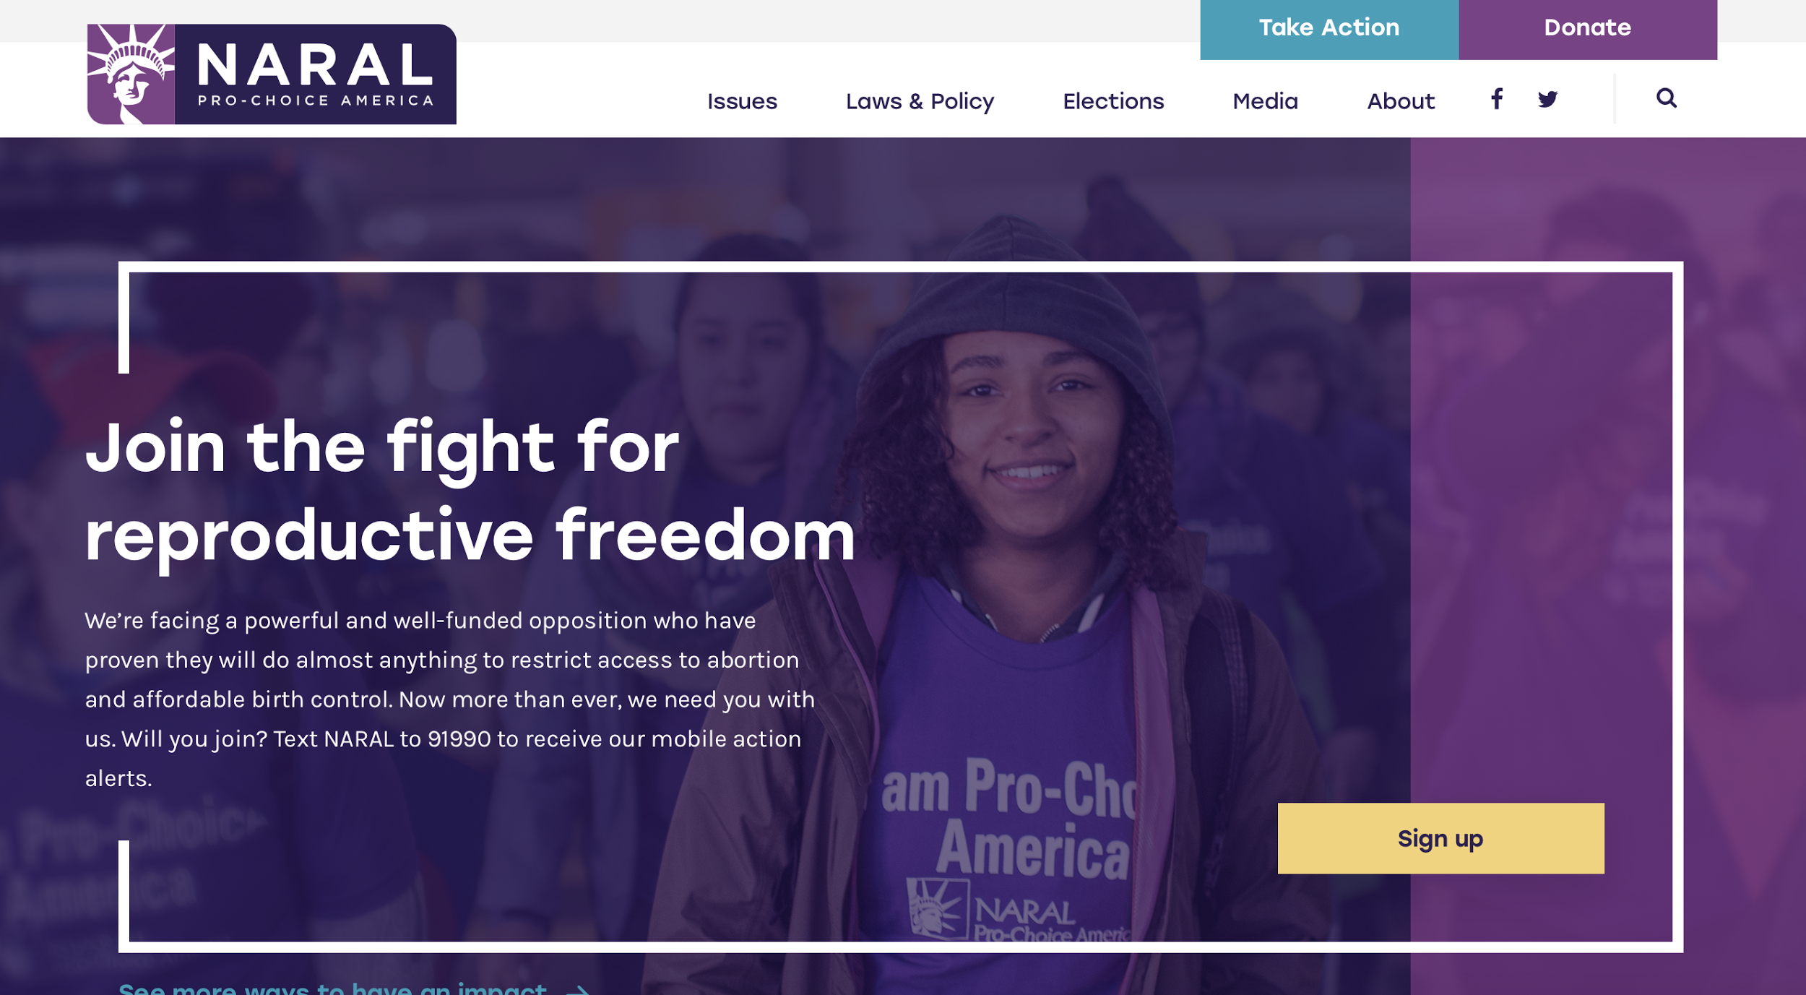
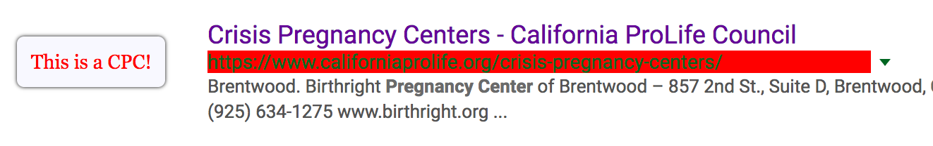
CPC Finder
Provide user with information about CPCs
Direct user to NARAL’s website

Slide 6
CPC Finder: Next Steps & Timeline
Week 6:
Work on extension’s graphics (with NARAL designer)
Design tooltip wireframe
Week 7:
Change URL-highlight to NARAL icon
Finish scraping data from 2 lists
Week 8:
Design reporting feature where users can add CPCs they identify
Talk with NARAL about promoting extension download
Week 9:
Implement reporting form & tie to extension
Week 10:
Create transition doc for NARAL team

Slide 7
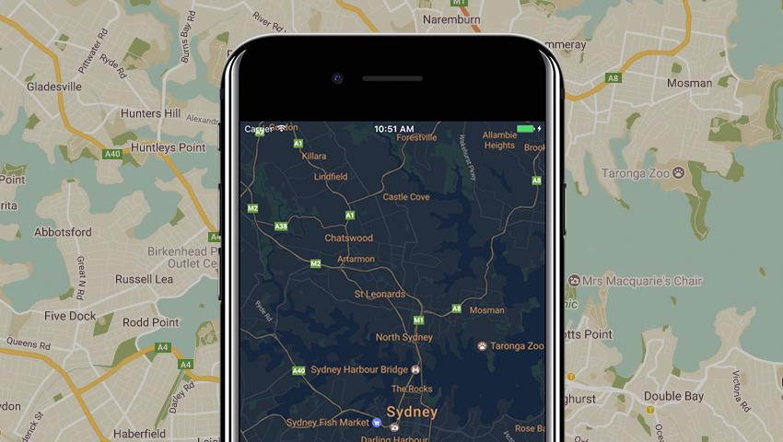
Business Shamer: iOS Application
iOS Application made in Swift / XCode
Using Google Map’s Swift API
Showing CPCs around you
Showing actual places for help around you
Connected to Database of CPCs, etc.
Possible Android Application?

